Slide 1
Developmental History of Transformers

Slide 2
Part | Topic / Component | Time (mins)
Part I | Introduction | 10
Part II | Focused Teaching – Intro to Transformers | 60
Part II | Focused Teaching – Dissecting Transformers | 60
Part III | Doubt Resolution | 20
Agenda

Slide 3
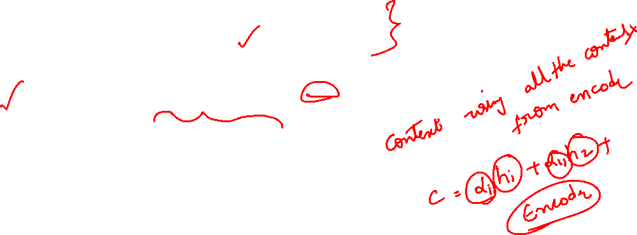
Encoder-Decoder Models:
Sequence-to-sequence tasks: e.g., translation, summarization
Encoder: Converts input → context vector
Decoder: Generates output from context vector
Limitation:
Fixed context vector struggles with long sequences
Attention Mechanism:
Decoder “focuses” on relevant input tokens at each step
Computes attention weights → dynamic context vector
Benefits:
Handles long sequences better
Improves accuracy
Adds interpretability

Slide 4
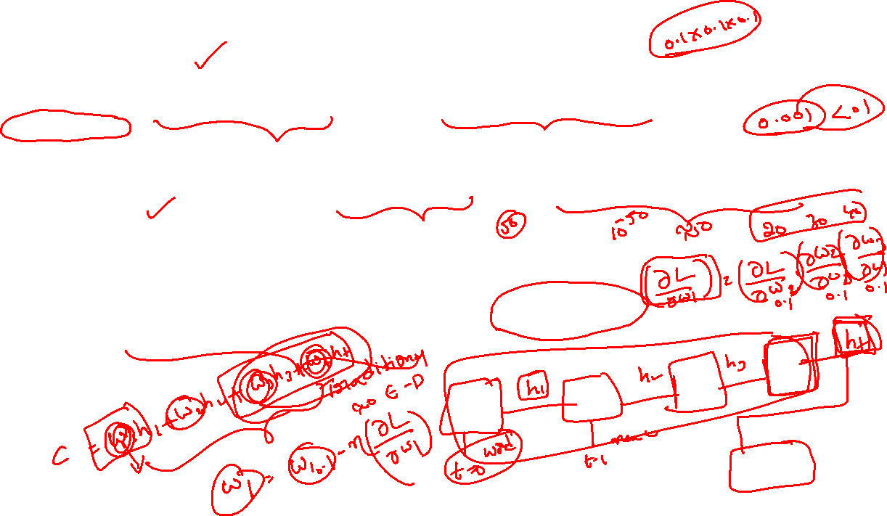
Issues with Attention in RNN Encoder-Decoder
Even with attention, there are some problems:
Sequential processing
RNNs/LSTMs process input one token at a time, so attention is computed over sequential states.
This means long sequences are slow because you can’t parallelize computations easily.
Distance bias
Attention works better for nearby words because the RNN struggles to propagate information across long distances.
So even attention may be biased toward recent hidden states, and long-range dependencies are harder to capture.
Inefficiency in decoder attention
Each decoder step recomputes attention over all encoder states, which can be computationally expensive for long sequences.
Limited context representation
Even with attention, the encoder states themselves are still RNN hidden states, which might not fully capture complex global dependencies in the sequence.

Slide 5

What Are Transformers?
Transformers were first created for tasks like machine translation, where one sequence (such as a sentence) is turned into another sequence. They are called Transformers because they transform an input sequence into an output sequence
Text Summarization:
Input Sequence: A long article or document.
Output Sequence: A shorter summary of the article.
Example: A 1000-word article → A 100-word summary.
Text Generation:
Input Sequence: A prompt or starting text.
Output Sequence: Continuation of the text.
Example: "Once upon a time" → "Once upon a time, there was a brave knight who..."
Language Translation:
Input Sequence: A sentence in English.
Output Sequence: The same sentence translated into Spanish.
Example: "Hello, how are you?" → "Hola, ¿cómo estás?“
Speech Recognition:
Input Sequence: Audio signal of spoken words.
Output Sequence: Text representing the spoken words.
Example: Audio of "Good morning" → Text "Good morning"

Slide 6
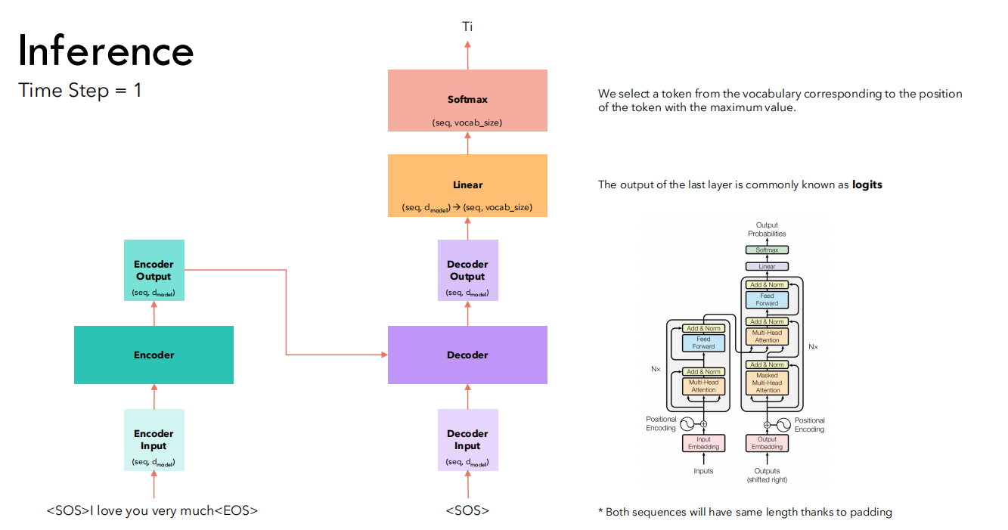
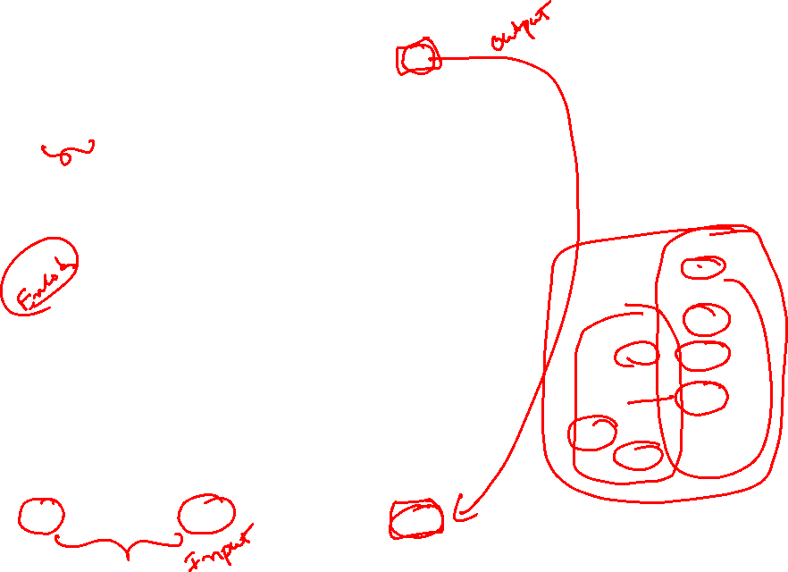

Slide 7
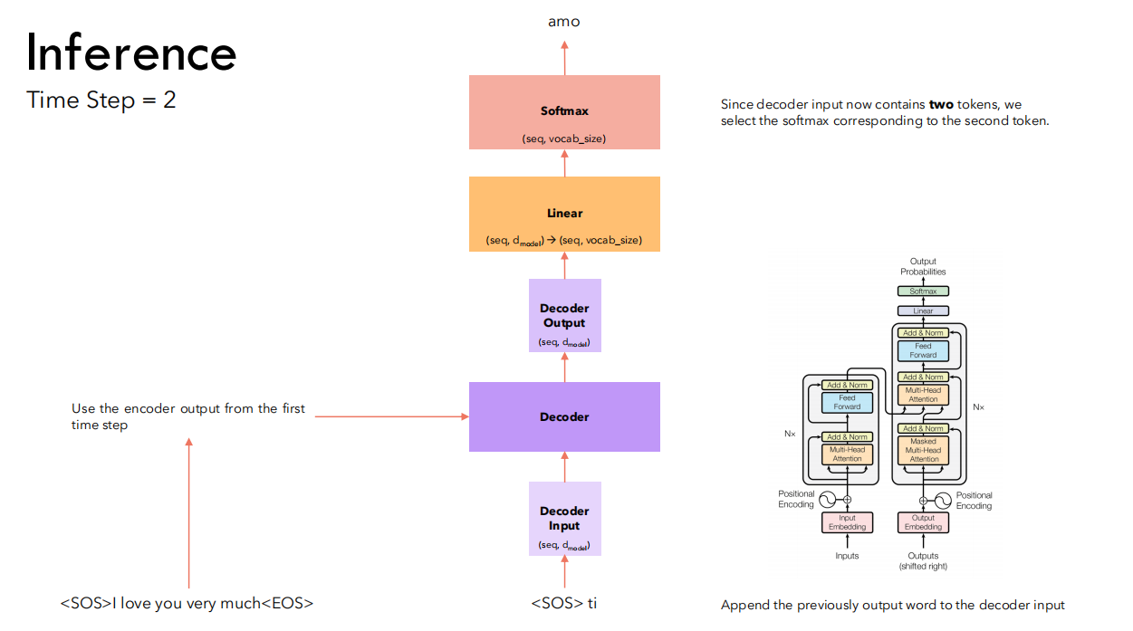


Slide 8
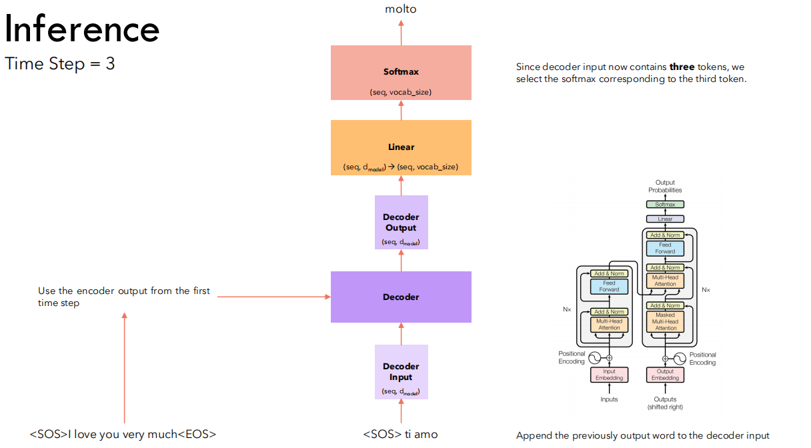


Slide 9
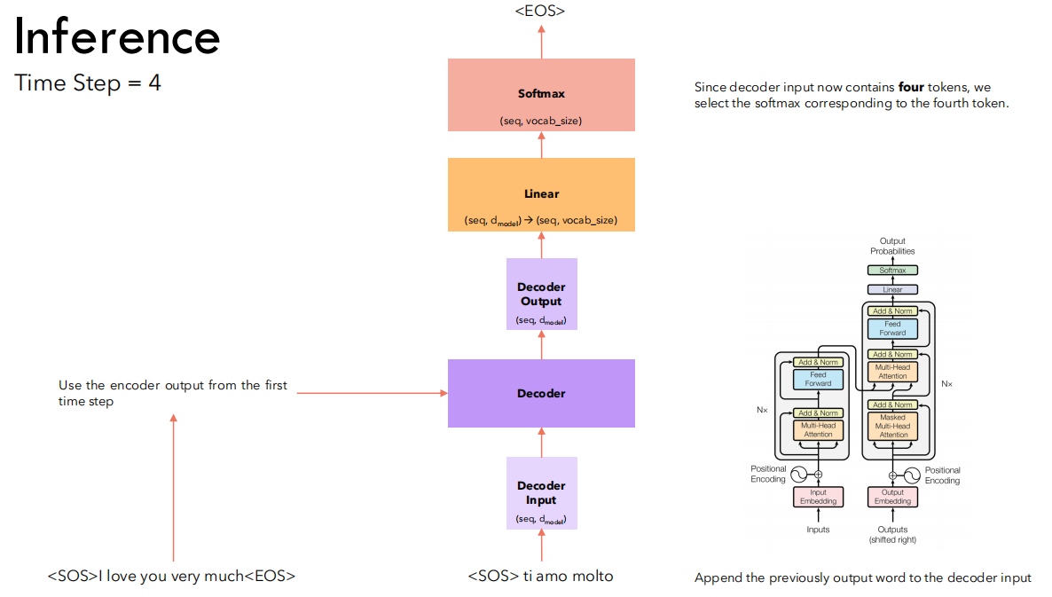
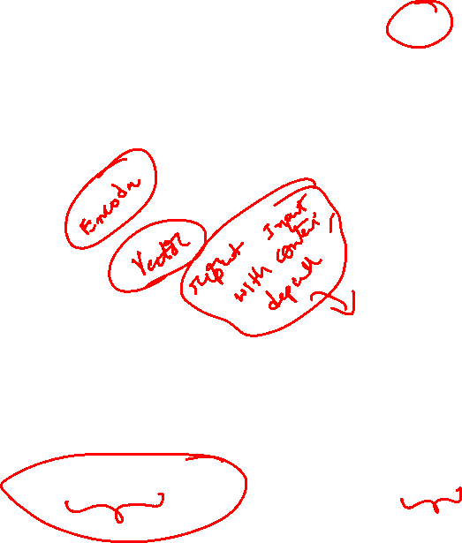

Slide 10
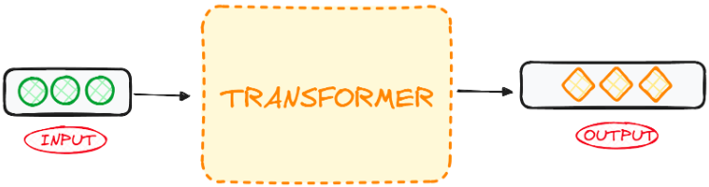

What Are Transformer Models?
A transformer model is an AI model that understands and generates text by learning patterns from large amounts of data. Instead of using RNNs, it uses attention to understand how words relate to each other, which helps it capture context better and perform well on language tasks.

Slide 11
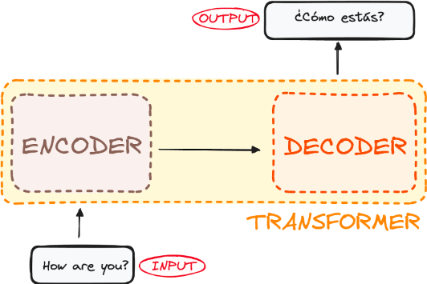
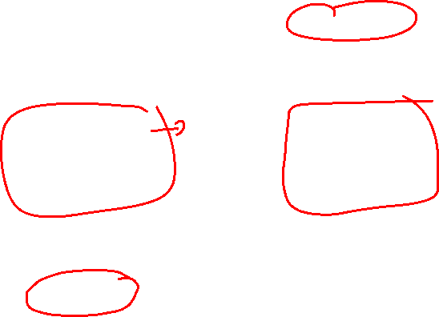
The Transformer Architecture
The encoder takes in our input and outputs a matrix representation of that input. For instance, the English sentence “How are you?”
The decoder takes in that encoded representation and iteratively generates an output. In our example, the translated sentence “¿Cómo estás?”

Slide 12
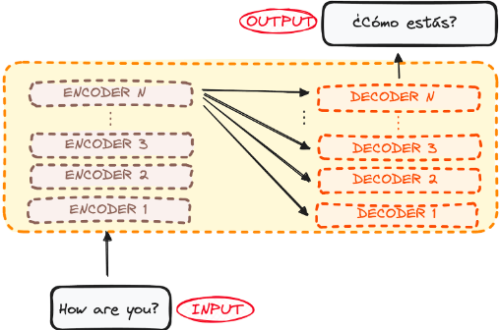
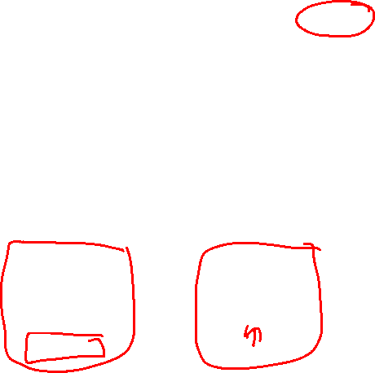
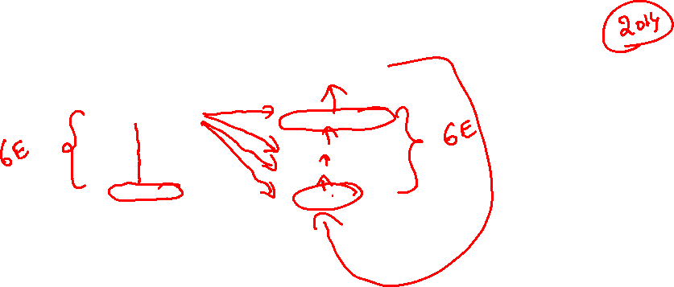
Encoder and the decoder are actually a stack with multiple layers (same number for each). All encoders present the same structure, and the input gets into each of them and is passed to the next one. All decoders present the same structure as well and get the input from the last encoder and the previous decoder.
The original architecture consisted of 6 encoders and 6 decoders, but we can replicate as many layers as we want. So let’s assume N layers of each.

Slide 13
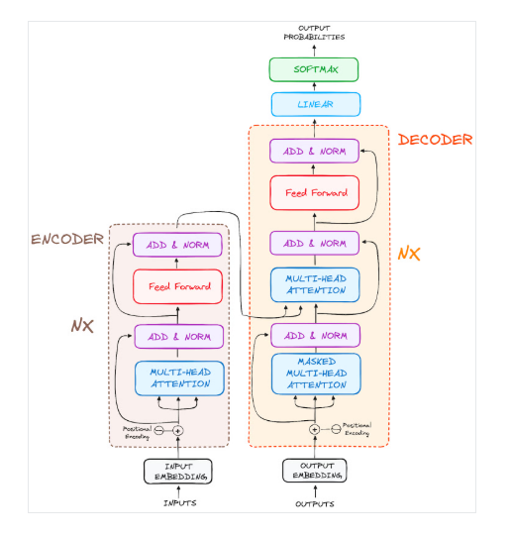
Architecture

Slide 14
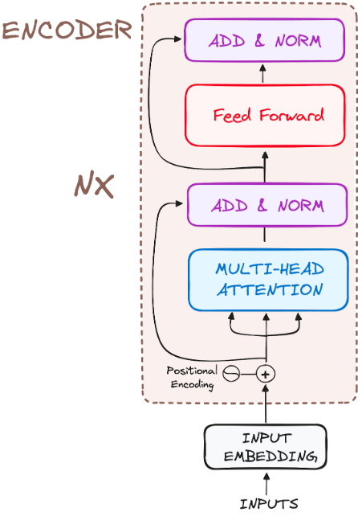
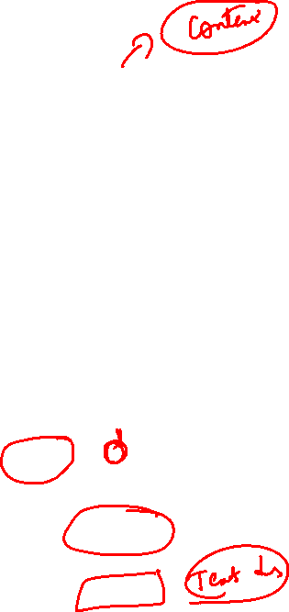
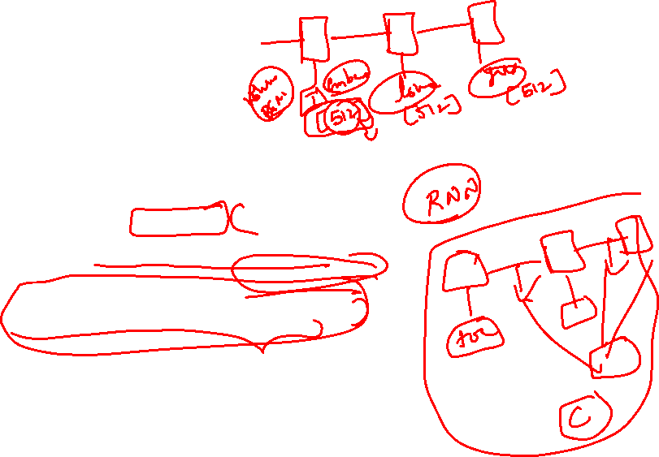
The Encoder Workflow
The encoder is a key part of the Transformer. Its main job is to turn input tokens into representations that include context. Instead of treating each token separately, the encoder understands each token based on the entire sequence.

Slide 15
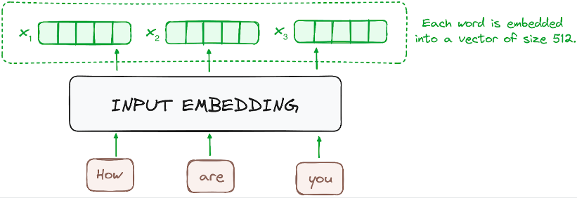
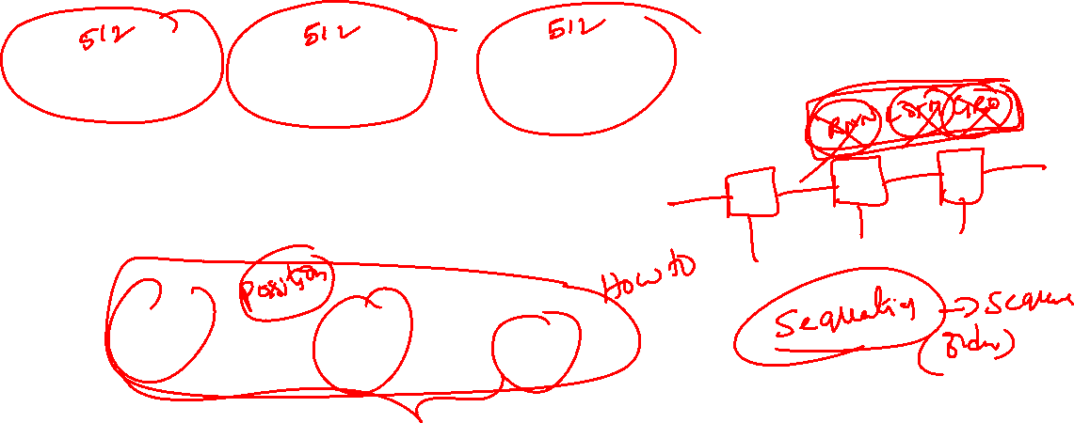
Input Embeddings
The embedding step happens only in the first (bottom) encoder. It converts input words or subwords into numerical vectors that represent their meaning.
Each encoder layer then works with a list of vectors of the same fixed size (for example, 512). The first encoder uses word embeddings as input, and every encoder above it uses the output from the encoder below.

Slide 16
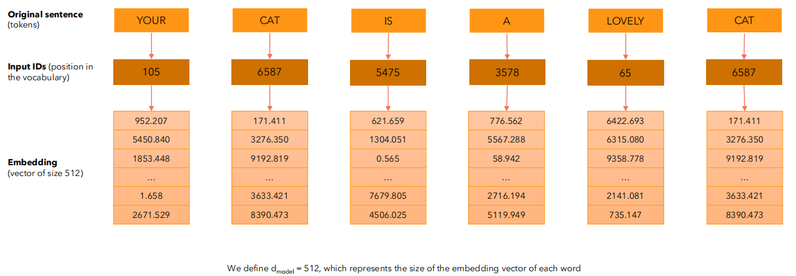
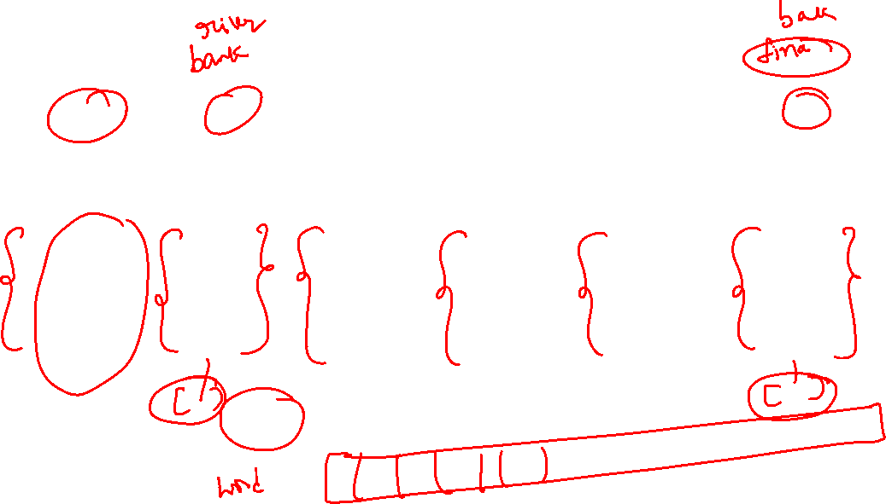

Slide 17
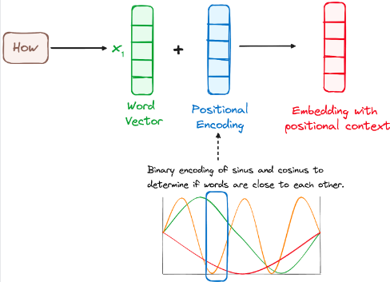

Positional Encoding
Transformers do not process words one by one like RNNs, so they need another way to know word order. They do this by adding positional encodings to word embeddings, which tell the model where each word appears in a sentence.
These positional encodings are created using sine and cosine functions, allowing the model to handle sentences of any length. Each position gets a unique pattern of values (between −1 and 1) across dimensions, helping the transformer understand the position of each word.

Slide 18
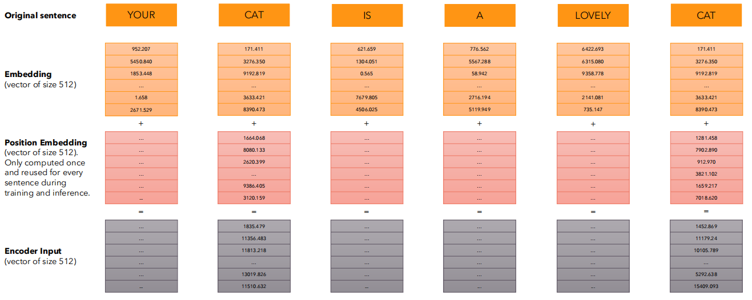
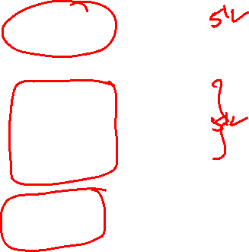
• We want each word to carry some information about its position in the sentence.
• We want the model to treat words that appear close to each other as “close” and words that are
distant as “distant”.
• We want the positional encoding to represent a pattern that can be learned by the model.

Slide 19
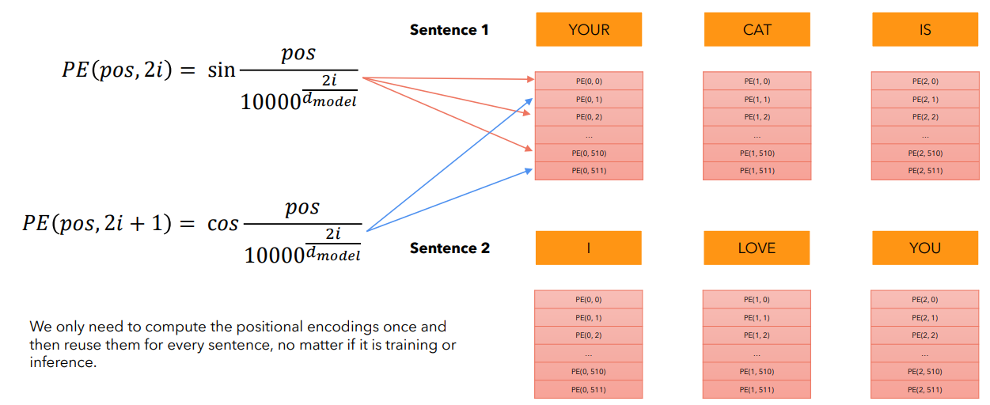
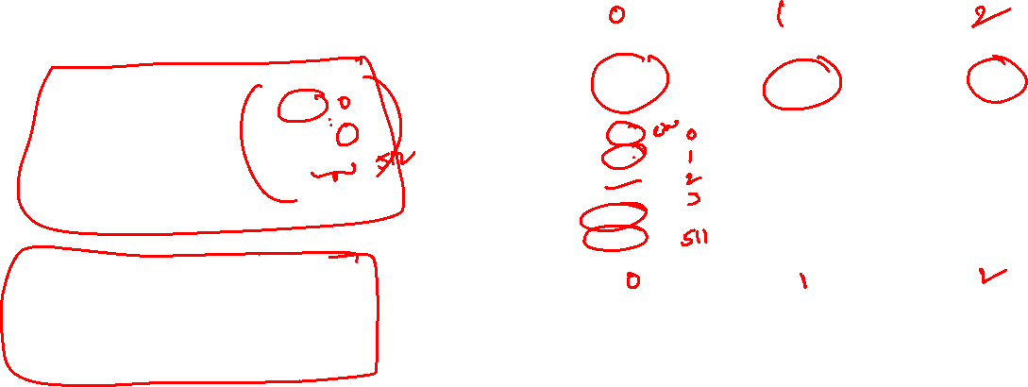
Trigonometric functions like cos and sin naturally represent a pattern that the model can recognize as continuous, so relative positions are easier to see for the model.

Slide 20
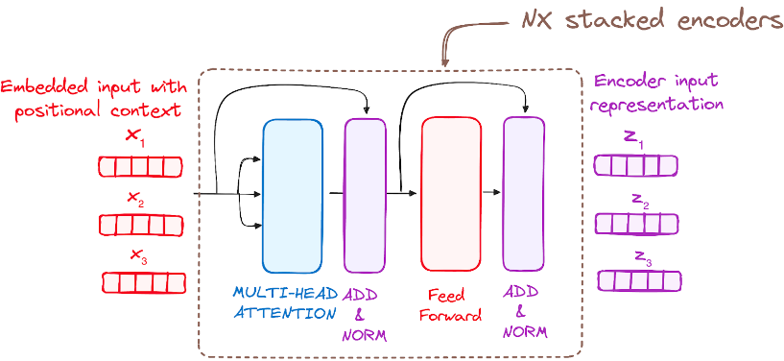
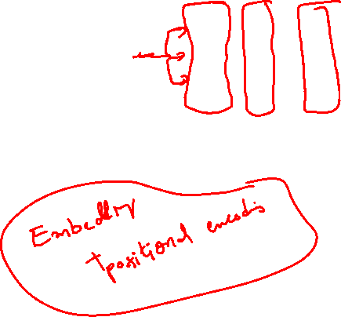
Stack of Encoder Layers
The Transformer encoder is made of several identical layers (6 in the original model). Each layer helps convert the input sequence into a richer representation that captures information from the whole sequence.
Each encoder layer has:
Multi-head attention to focus on important parts of the sequence
A feed-forward (fully connected) network to process the information
To improve learning, residual connections and layer normalization are applied around each part.

Slide 21
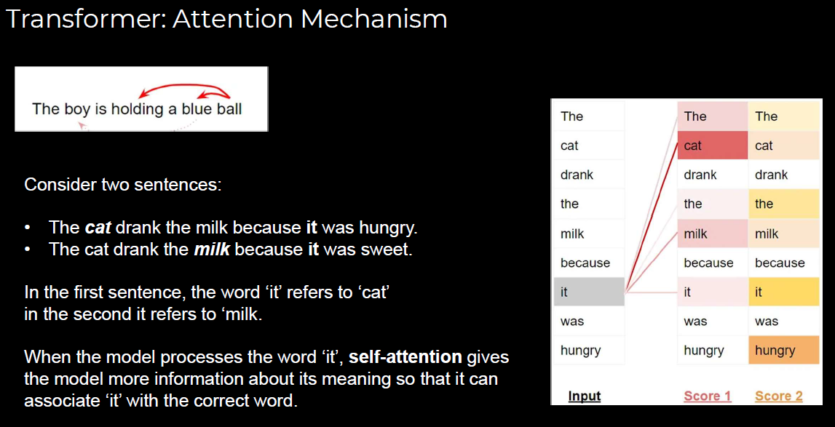
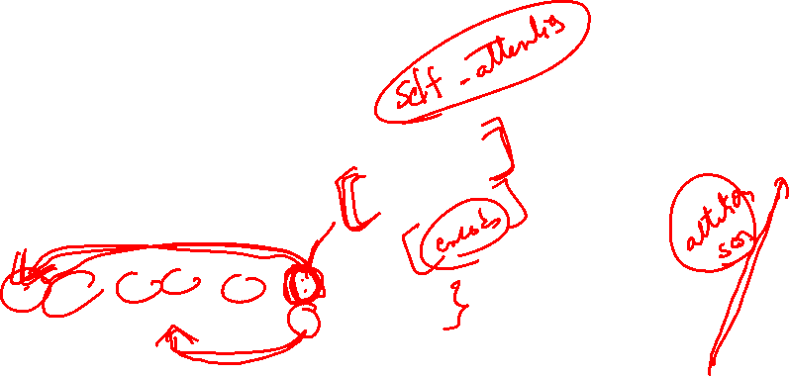

Slide 22
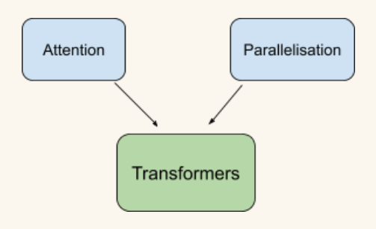
Transformers is Attention-Driven Architecture for Complex Language Tasks
The Transformer architecture, introduced in “Attention Is All You Need”, replaces sequential processing (used in RNNs) with a fully attention-based design.
Unlike RNN-based encoder–decoder models, transformers process entire sequences in parallel, significantly improving speed and scalability.
The core mechanism is Self-Attention, which allows each word to:
Examine all other words in the sentence simultaneously
Determine contextual importance regardless of position or distance
This approach overcomes major RNN limitations:
Difficulty handling long sentences
Vanishing gradient problems
Slow training due to sequential computation
Multi-Head Attention enables the model to capture:
Syntactic relationships (grammar)
Semantic meaning (context and intent)
Long-range dependencies between distant words

Slide 23
Parallelization in Transformers: Enabling Advanced NLP and Code Generation
Key Points:
Transformers process tokens simultaneously, unlike RNNs which process one step at a time.
Parallelization enables:
Efficient handling of long sentences
Reduced training time on large corpora
Improved performance on complex reasoning tasks
Attention allows the model to dynamically focus on relevant context, ensuring meaning is preserved across the entire input.
Strategic Value:
Powers modern AI systems such as GPT models
Enables applications beyond translation:
Code generation
Question answering
Summarization
Conversational AI

Slide 24
Encoder–Decoder with Attention: Intuitive Understanding
The encoder–decoder mechanism is like translating a sentence:
First, the input is read and its context is understood
Then, the output is generated step by step
The encoder converts the input sequence (x₁, x₂, …, xₙ) into a richer representation (z₁, z₂, …, zₙ), capturing details the raw input may miss.
The key idea of context capture remains unchanged: each word’s representation depends on other words.
In transformers, this dependency is handled using attention.
The decoder generates the output sequence (y₁, y₂, …, yₘ), where the output length m may differ from input length n.
To generate each word yᵢ, the decoder uses:
Encoder–Decoder Attention: focuses on (z₁, z₂, …, zₙ) to understand input context
Self-Attention: considers previously generated words (y₁, y₂, …, yᵢ₋₁) for coherence

Slide 25
Intuition Behind Attention (Team Project Analogy)
Attention can be understood using a group project analogy.
Imagine a team of five people:
Each person reads different chapters of a book independently.
Everyone develops:
Understanding of content → called Values (V)
Questions about the content → called Queries (Q)
Key insights or summaries → called Keys (K)
When the team meets:
Each person asks questions (Queries)
Others respond if their insights (Keys) are relevant
Similarly, in a transformer:
The decoder provides Queries (Q)
The encoder provides Keys (K) and Values (V)
Attention determines which information is most relevant

Slide 26
Intuition Behind Queries (Q), Keys (K), and Values (V)
Think again about the group project.
Each person reads a different chapter and comes to the meeting prepared.
1. Keys (K) – “What do I know?”
A Key is like a short label or summary of what someone knows.
It helps others decide whether this person is relevant to their question.
Example: “I studied Chapter 3 about photosynthesis.”
2. Queries (Q) – “What am I looking for?”
A Query is a question someone asks to find useful information.
Example: “Who knows how plants make food?”
3. Matching Queries and Keys
When someone asks a question (Query), they compare it with everyone else’s Keys.
If a Key matches the Query well, that person is considered important for that question.
4. Values (V) – “The actual information”
Values are the full knowledge or details a person has.
Once attention decides who is relevant, it takes information from their Values.
Example: Explanation of photosynthesis, equations, examples, diagrams.

Slide 27
How this maps to Transformers
Query (Q): What the model is currently trying to understand
Key (K): A tag describing each word’s information
Value (V): The actual meaning or information of each word
Important relationship:
🔑 Queries are matched with Keys to decide how much attention to give, 📦 and Values provide the information that gets passed forward.
Queries ask, Keys decide relevance, and Values deliver the information.

Slide 28
Intuition Behind the Attention Formula
Goal: Decide which information matters most for the current word.
Step-by-Step
Query (Q): What am I looking for right now?
Keys (K): What does each word/person know?
Similarity Score: Query · Key → Measures how relevant each key is to the query
SoftMax: Attention Weight = SoftMax(Q · K) → Converts scores into percentages → All weights sum to 1 → More relevant keys get higher weight
Values (V): The actual information to use
Final Output: Attention Output = Attention Weights × Values → Take more information from important values → Take less from unimportant ones
The final attention output represents a weighted combination of information, focusing on what matters most for the current query.

Slide 29
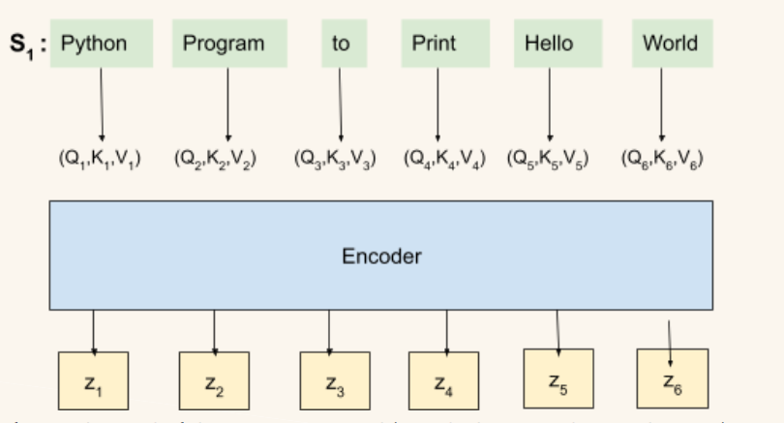
Convert a natural language instruction into Python code
“Python program to print Hello, world!”
In a transformer, each word works like a team member in a group project.
Every word creates three vectors:
Query (Q): what the word is looking for
Key (K): what the word offers
Value (V): the information the word contains
The encoder processes all words together and produces a representation for each word:
(z₁, z₂, …, z₆) for words like Python, program, to, print, Hello, world
Each word improves its understanding by interacting with other words using attention.
This allows the model to understand context, not just individual words.

Slide 30
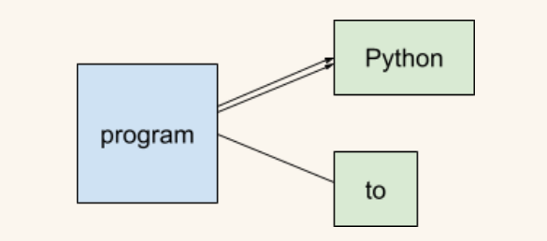
Attention in Action (Attention Weights × Values)
Consider the word “program”:
Its query (Q) matches strongly with the key (K) of the word “Python”
This helps clarify what type of program is being described
Words like “to” provide less useful context and receive lower attention
This is captured using attention weights (α):
Higher weights for relevant words
Lower weights for less relevant words
The final representation for a word (e.g., z₂ for “program”) is computed as:
z₂ = α₁V₁ + α₂V₂ + … + α₆V₆
The attention weights:
Always sum to 1
Control how much each word contributes
This process is repeated for every word, allowing all words to collaboratively refine their meanings

Slide 31
Decoder – Step-by-Step Output Generation
The decoder generates the output one word at a time, starting from scratch.
It begins with a special <start> token, which signals the start of generation.
At this stage, no translation has occurred yet.
To generate the first word (e.g., print):
The decoder attends to the encoder outputs
It focuses more on relevant input words such as “Python” and “program”
Less relevant words receive lower attention
Based on this attention, the decoder predicts the first output token.

Slide 32
Decoder Attention Flow & Final Output
Once print is generated, it is fed back into the decoder as input for the next step.
The decoder now uses:
Self-Attention: to understand previously generated words and the <start> token
Encoder–Decoder Attention: to align output with the encoded input
The decoder asks: “What should I generate next?”
Based on this, it predicts the next token (e.g., ().
This process repeats:
Each generated word is refined using self-attention
Encoder information guides the next prediction
The sequence continues until the full output is produced:
Through training, the model learns where to focus by optimizing attention weights.
Together, the encoder and decoder enable efficient, accurate sequence generation.

Slide 33
Transformers Are Built on Matrix Operations
Deep learning models like Transformers and GPTs may seem magical, but they are built on matrix multiplications.
Every major operation in a transformer:
Attention
Context building
Representation learning is done using matrices and vectors.
Example:
Input sentence with n words
Each word starts as a basic vector of size d₁
These initial vectors:
Do not fully capture meaning or context
Are static (same word → same vector)
Goal of the transformer:
Convert these into richer, context-aware vectors of size d₂
This is done by stacking all word vectors into an input matrix X (n × d₁).

Slide 34

From Input Matrix to Attention-Based Representation
From the input matrix X, the model creates three new matrices:
Query (Q) → what each word is looking for
Key (K) → what each word offers
Value (V) → the actual information of each word
These are computed using learned weight matrices:
Q = X × WQ
K = X × WK
V = X × WV
Each resulting matrix has size n × d₂.
Example:
The word “program” may query other words
It may match strongly with the key of “Python”
Attention scores are calculated using:
Q × Kᵀ, followed by softmax
Softmax ensures:
Scores sum to 1
Important words receive higher attention
These attention weights are applied to V to produce:
A new matrix n × d₂
Each word now has a context-aware representation
Result:
Words learn from each other
The entire sentence contributes to understanding each word

Slide 35
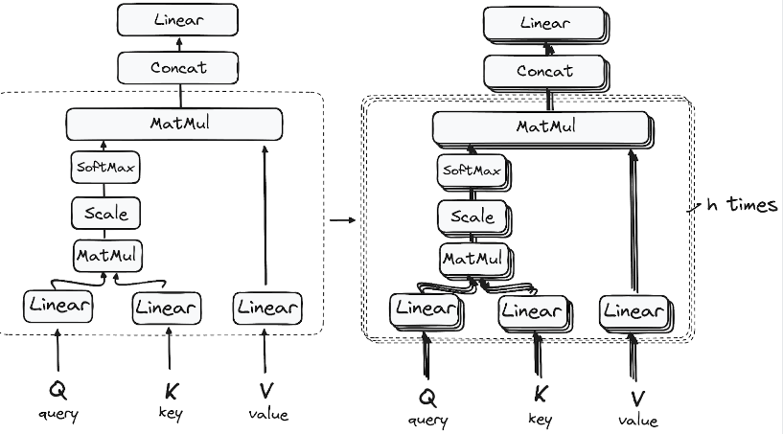
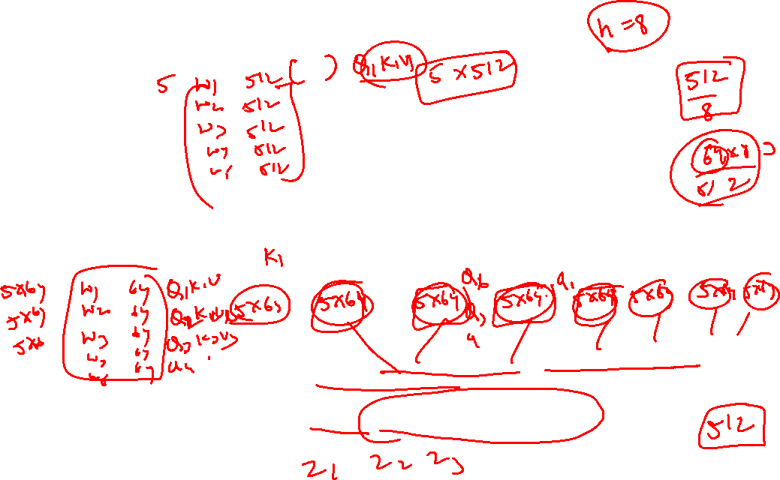
STEP 3.1 Multi-Headed Self-Attention Mechanism
In the encoder, the multi-headed attention utilizes a specialized attention mechanism known as self-attention. This approach enables the models to relate each word in the input with other words.
This mechanism allows the encoder to focus on different parts of the input sequence as it processes each token. It computes attention scores based on:
A query is a vector that represents a specific word or token from the input sequence in the attention mechanism.
A key is also a vector in the attention mechanism, corresponding to each word or token in the input sequence.
Each value is associated with a key and is used to construct the output of the attention layer. When a query and a key match well, which basically means that they have a high attention score, the corresponding value is emphasized in the output.
This first Self-Attention module enables the model to capture contextual information from the entire sequence. Instead of performing a single attention function, queries, keys and values are linearly projected h times. On each of these projected versions of queries, keys and values the attention mechanism is performed in parallel, yielding h-dimensional output values.

Slide 36

Simple Intuition for Multi-Head Attention
Think of reading a sentence with different goals.
Single-Head Attention
It’s like one student reading a sentence and trying to understand everything at once.
They can focus on only one type of relationship at a time (for example, meaning or grammar).
Important details may be missed.
Multi-Head Attention
Now imagine several students reading the same sentence together:
One focuses on meaning
One focuses on grammar
One focuses on word order
One focuses on important keywords
Each student is an attention head.
All heads look at the same sentence
Each head focuses on different relationships
Their insights are combined to get a better overall understanding
As a result, the model gains a richer understanding of the input sequence

Slide 37
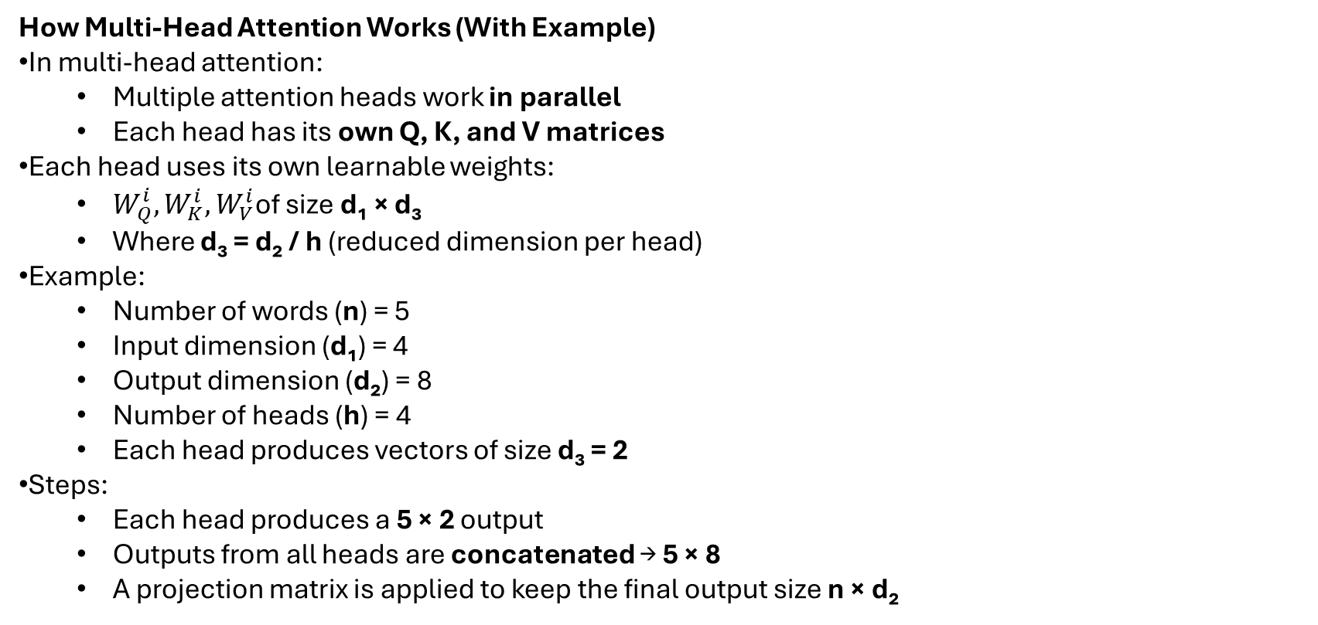
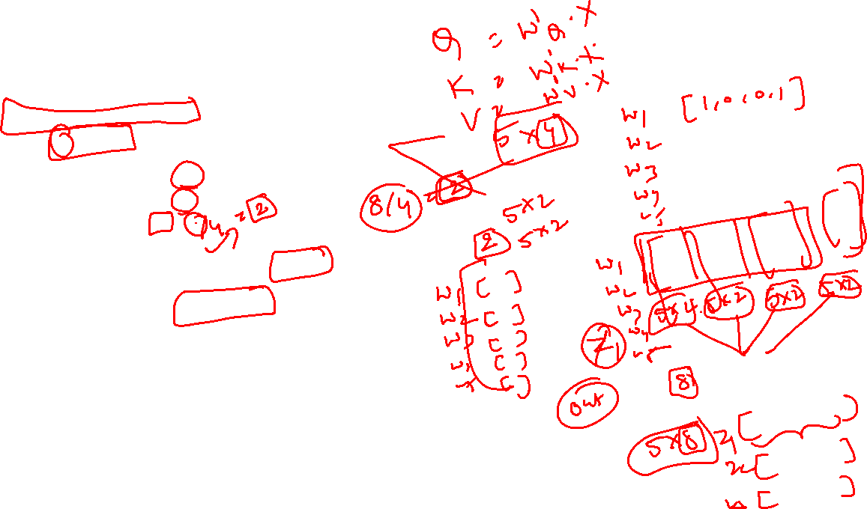
How Multi-Head Attention Works (With Example)
In multi-head attention:
Multiple attention heads work in parallel
Each head has its own Q, K, and V matrices
Each head uses its own learnable weights:
$W_{Q}^{i},W_{K}^{i},W_{V}^{i}$of size d₁ × d₃
Where d₃ = d₂ / h (reduced dimension per head)
Example:
Number of words (n) = 5
Input dimension (d₁) = 4
Output dimension (d₂) = 8
Number of heads (h) = 4
Each head produces vectors of size d₃ = 2
Steps:
Each head produces a 5 × 2 output
Outputs from all heads are concatenated → 5 × 8
A projection matrix is applied to keep the final output size n × d₂
Benefit:
Different heads focus on different aspects of the input
Produces more diverse and informative representations
This makes multi-head attention especially powerful for NLP tasks.

Slide 38
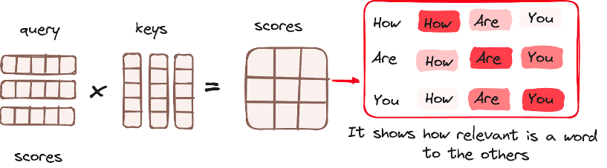
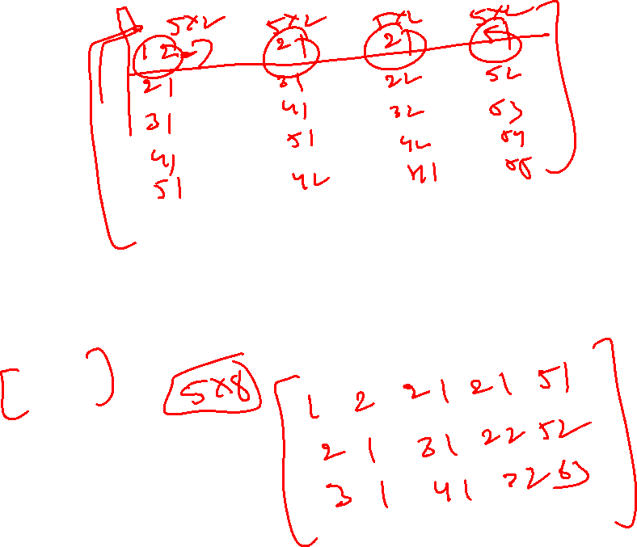
Matrix Multiplication (MatMul) - Dot Product of Query and Key
Once the query, key, and value vectors are passed through a linear layer, a dot product matrix multiplication is performed between the queries and keys, resulting in the creation of a score matrix.
The score matrix establishes the degree of emphasis each word should place on other words.
Therefore, each word is assigned a score in relation to other words within the same time step. A higher score indicates greater focus.
This process effectively maps the queries to their corresponding keys.

Slide 39
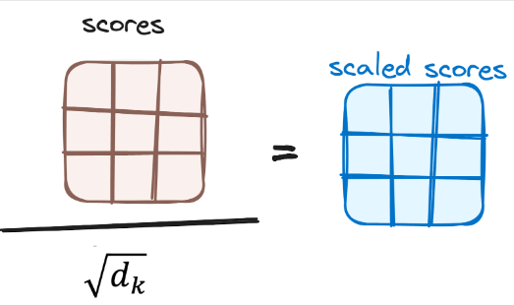
Reducing the Magnitude of attention scores
The scores are then scaled down by dividing them by the square root of the dimension of the query and key vectors. This step is implemented to ensure more stable gradients, as the multiplication of values can lead to excessively large effects.

Slide 40
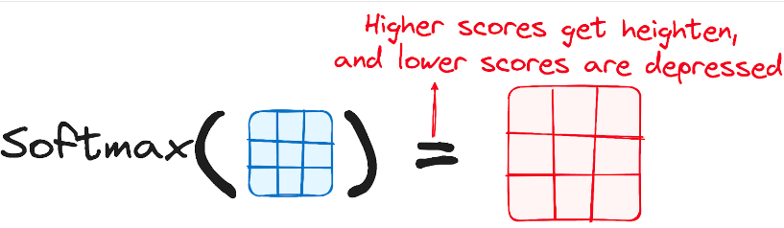
Applying Softmax to the Adjusted Scores
Subsequently, a softmax function is applied to the adjusted scores to obtain the attention weights. This results in probability values ranging from 0 to 1. The softmax function emphasizes higher scores while diminishing lower scores, thereby enhancing the model's ability to effectively determine which words should receive more attention.

Slide 41
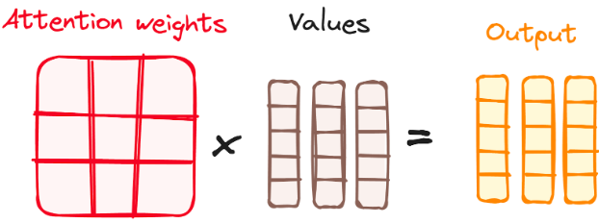
Combining Softmax Results with the Value Vector
The following step of the attention mechanism is that weights derived from the softmax function are multiplied by the value vector, resulting in an output vector.
In this process, only the words that present high softmax scores are preserved. Finally, this output vector is fed into a linear layer for further processing.

Slide 42
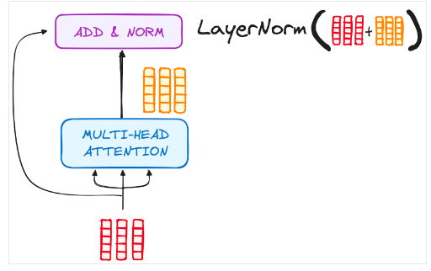
Normalization and Residual Connections
Each sub-layer in an encoder layer is followed by a normalization step. Also, each sub-layer output is added to its input (residual connection) to help mitigate the vanishing gradient problem, allowing deeper models. This process will be repeated after the Feed-Forward Neural Network too.

Slide 43
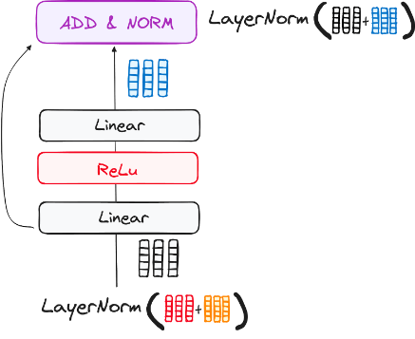
Feed-Forward Neural Network
The journey of the normalized residual output continues as it navigates through a pointwise feed-forward network, a crucial phase for additional refinement.
Picture this network as a duo of linear layers, with a ReLU activation nestled in between them, acting as a bridge. Once processed, the output embarks on a familiar path: it loops back and merges with the input of the pointwise feed-forward network.
This reunion is followed by another round of normalization, ensuring everything is well-adjusted and in sync for the next steps.

Slide 44
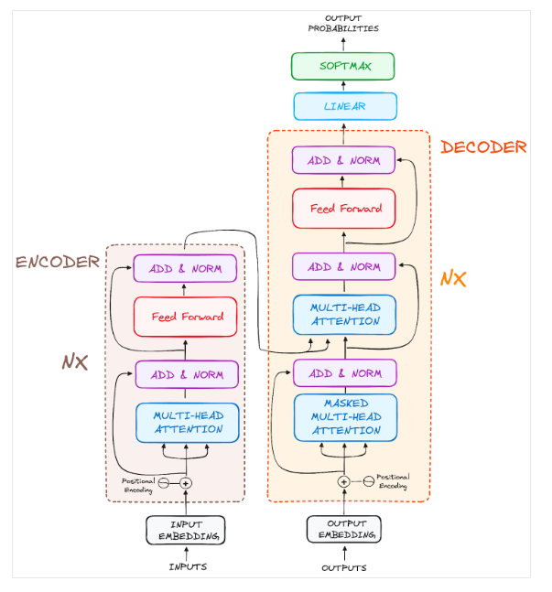
Output of the Encoder
The final encoder layer produces vectors that represent each word in context, capturing the meaning of the whole sequence.
These vectors are then passed to the decoder, helping it focus on the right words when generating output.
Think of the encoder as a tower of layers:
Each layer learns something new about the input
Stacking layers gives the model a deeper and richer understanding
This makes the transformer much better at predicting or generating text

Slide 45
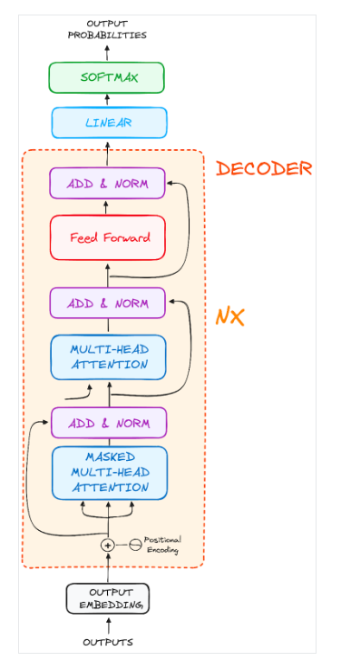
The Decoder WorkFlow
The decoder in a Transformer model is responsible for generating text sequences. It is similar to the encoder and consists of several layers, including two multi-headed attention layers, a feed-forward layer, and mechanisms for residual connections and layer normalization.
Unlike the encoder, the decoder's attention layers have specific tasks. The final step in the decoder's process involves a linear layer that acts as a classifier, followed by a softmax function that calculates the probabilities of different words.
The Transformer decoder is designed to generate output by decoding the encoded information step by step.
It works in an autoregressive manner, starting with a special start token and using previously generated words as inputs along with the encoder's outputs, which contain rich attention information from the initial input.
This process continues until the decoder generates a token that signals the end of the sequence, completing its output creation.

Slide 46
STEP 1 - Output Embeddings
At the decoder's starting line, the process mirrors that of the encoder. Here, the input first passes through an embedding layer
STEP 2 - Positional Encoding
Following the embedding, again just like the decoder, the input passes by the positional encoding layer. This sequence is designed to produce positional embeddings.
These positional embeddings are then channeled into the first multi-head attention layer of the decoder, where the attention scores specific to the decoder’s input are meticulously computed.
STEP 3 - Stack of Decoder Layers
The decoder consists of a stack of identical layers (6 in the original Transformer model). Each layer has three main sub-components:
STEP 3.1 Masked Self-Attention Mechanism
STEP 3.2 - Encoder-Decoder Multi-Head Attention or Cross Attention
STEP 3.3 Feed-Forward Neural Network
STEP 4 Linear Classifier and Soft-max for Generating Output Probabilities

Slide 47
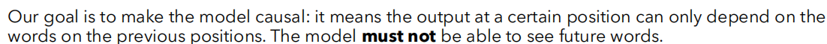
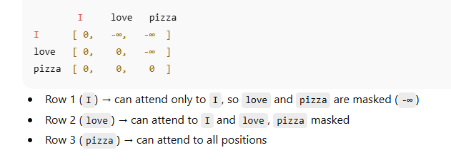
What is Masked Multi-Head Attention?
Apply SoftMax
The -∞ values become 0 after SoftMax
The model ignores future words
The -∞ is just a way to prevent the model from seeing future words.

Slide 48
How masking works during training
During training, we actually already know the target sentence.
Example target: "I love to eat pizza"
We don’t let the model “see the future”, even though we know it.
For predicting the first word "I" → mask "love to eat pizza"
For predicting "love" → mask "to eat pizza"
And so on
The mask is created automatically:
Usually, an upper triangular matrix is used for the target sequence length.
This ensures word i can only attend to words ≤ i
Why we know the future during training:
We have the ground-truth target sequence in training
Masking is applied mathematically, so the model can’t cheat by using future words
Position | Can attend to | Masked positions
1 (I) | I | love, to, eat, pizza
2 (love) | I, love | to, eat, pizza
3 (to) | I, love, to | eat, pizza
… | … | …

Slide 49
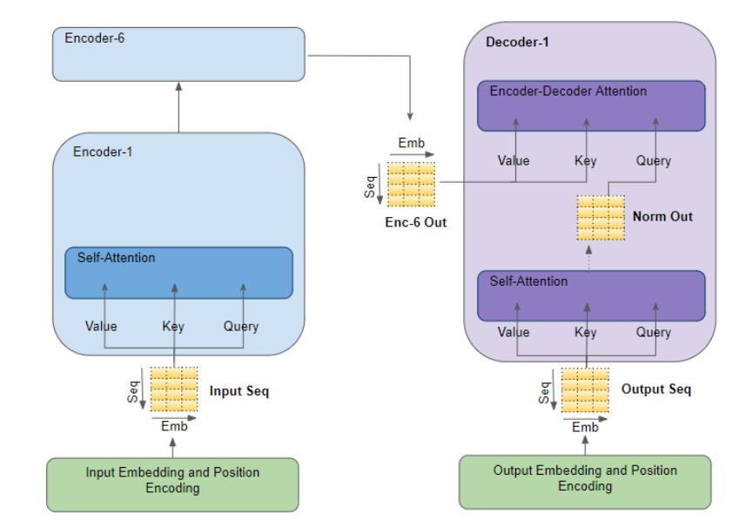
Encoder-Decoder Multi-Head Attention or Cross Attention
Decoder’s Second Multi-Headed Attention (Encoder-Decoder Attention)
Purpose: This layer lets the decoder look at the encoder’s output and focus on the most important parts of the input sequence while generating words.
How it works:
Queries (Q): From the decoder’s previous layer
Keys (K) and Values (V): From the encoder’s output
This allows the decoder to align its output with the relevant input
After attention:
The output goes through a feed-forward layer for refinement
Each word in the decoder can now use information from all positions in the input

Slide 50
Feed-Forward Neural Network
Similar to the encoder, each decoder layer includes a fully connected feed-forward network, applied to each position separately and identically.

Slide 51

Linear Classifier and Softmax for Generating Output Probabilities
The journey of data through the transformer model culminates in its passage through a final linear layer, which functions as a classifier.
The size of this classifier corresponds to the total number of classes involved (number of words contained in the vocabulary). For instance, in a scenario with 1000 distinct classes representing 1000 different words, the classifier's output will be an array with 1000 elements.
This output is then introduced to a softmax layer, which transforms it into a range of probability scores, each lying between 0 and 1. The highest of these probability scores is key,its corresponding index directly points to the word that the model predicts as the next in the sequence.

Slide 52
Normalization and Residual Connections
Each sub-layer (masked self-attention, encoder-decoder attention, feed-forward network) is followed by a normalization step, and each also includes a residual connection around it.
Output of the Decoder
The final layer's output is transformed into a predicted sequence, typically through a linear layer followed by a soft-max to generate probabilities over the vocabulary.
The decoder, in its operational flow, incorporates the freshly generated output into its growing list of inputs, and then proceeds with the decoding process. This cycle repeats until the model predicts a specific token, signaling completion.
The token predicted with the highest probability is assigned as the concluding class, often represented by the end token.
Again, remember that the decoder isn't limited to a single layer. It can be structured with N layers, each one building upon the input received from the encoder and its preceding layers. This layered architecture allows the model to diversify its focus and extract varying attention patterns across its attention heads.
Such a multi-layered approach can significantly enhance the model’s ability to predict, as it develops a more nuanced understanding of different attention combinations.

Slide 53

Questions?

